Slide 1
KCGL ERP - Part Detail Info (PDI)
How to use the PDI (Part Detail Info) module in the ERP
Covers two sections:
1. Quotation Template - for all employees: select an Application Code, see the service parts / kits and export the quotation PDF
2. Master Report - for Master Admin: reports, master data, app mapping, service names and Excel import
Every step has a screenshot with red markers ①, ②, ③ showing exactly where to click

Slide 2
PDI Guidelines and Terminologies
Module | Part Detail Info (PDI) - service part library by Application Code
Purpose | Quickly find the service parts and kits of any Application Code, generate the quotation PDF, and (Master Admin) manage the master data behind it
Intended Users | All Employees (Quotation Template) / Master Admin (Master Report). Master Admin grants page access from the Profile page
App Code | Application Code - one engine configuration (e.g., 04.1341). Everything in PDI is stored under it
Type of Service | Service interval such as 500 Hrs (B-Check). A part belongs to a service by its Service Hours
Part Line | One service part - Part Number, Description, Qty, Action and Svc Hrs
Kit | A maintenance kit holding its own copies of part lines. After import, parts and kits are independent
Action (R / C / T) | R = Replace, C = Check, T = Top-up - shown as coloured chips on every part line
Master Report tabs | Service Applicability, Search Activity Count, Master Data, App Mapping, Master of Service, Import Data
Note: The Part Detail Info menu appears only after the Master Admin grants access from Profile → Edit Employee → Part Detail Info Access. Employees see only the Quotation Template page; the Master Report page opens for the Master Admin only.

Slide 3
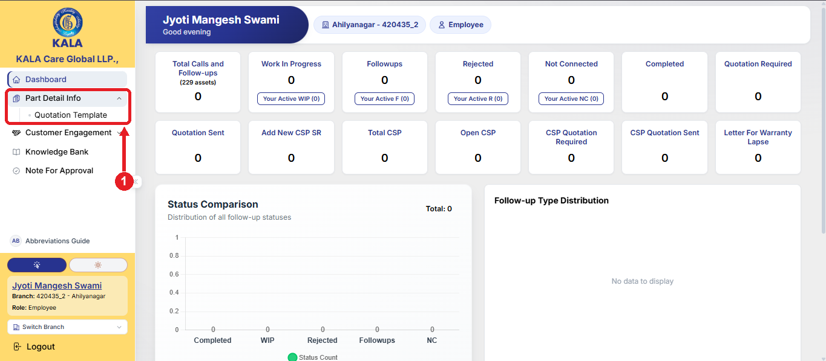
PDI Steps - Section 1: Quotation Template (For All Employees)
Step 1: Log in to the portal. In the left menu, click Part Detail Info and then click Quotation Template ①. The menu is visible only when the Master Admin has granted you access to this page

Slide 4
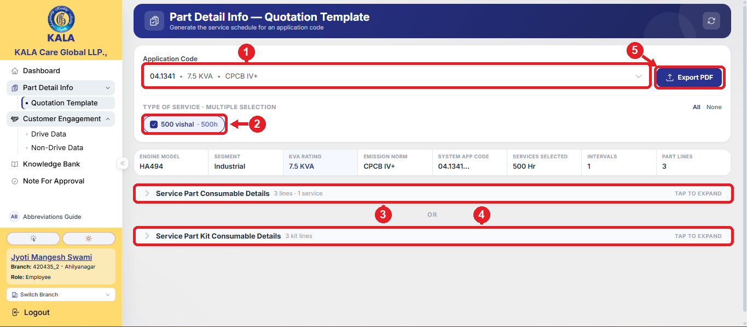
PDI Steps - Section 1: Quotation Template (For All Employees)
Step 2: Select the Application Code from the dropdown ① - you can search by App Code, KVA or Emission Norm. Then tick the required Type of Service ② (500 Hrs etc.). The page shows the engine details strip and two sections - click Service Part Consumable Details ③ or Service Part Kit Consumable Details ④ to expand it (Action chips: R = Replace, C = Check, T = Top-up). Then click Export PDF ⑤

Slide 5
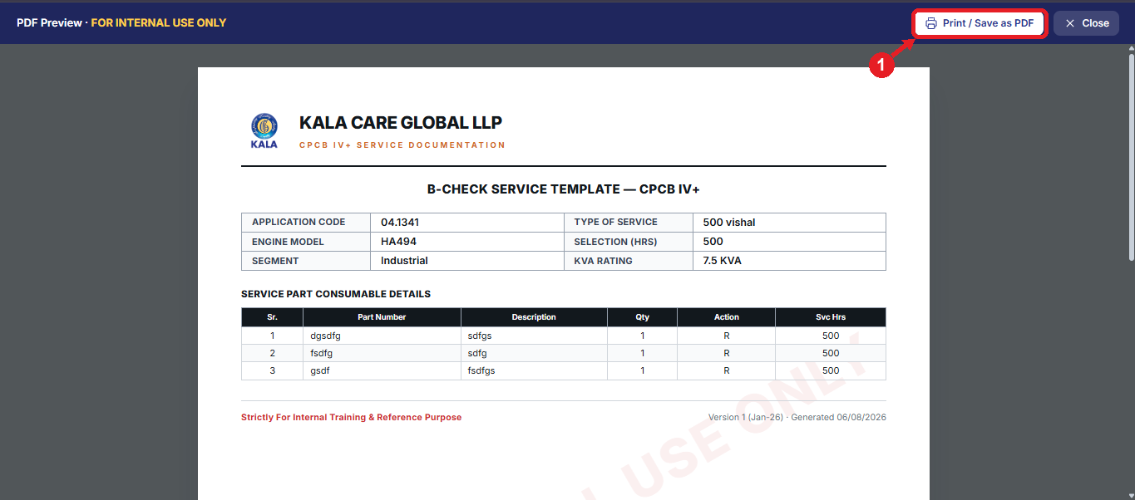
PDI Steps - Section 1: Quotation Template (For All Employees)
Step 3: After clicking Export PDF, a preview of the service template opens with the company header, the code details and the part / kit table of the open section. Click Print / Save as PDF ① to print or save it. The sheet is watermarked “FOR INTERNAL USE ONLY” - it is for internal training and reference purpose only

Slide 6
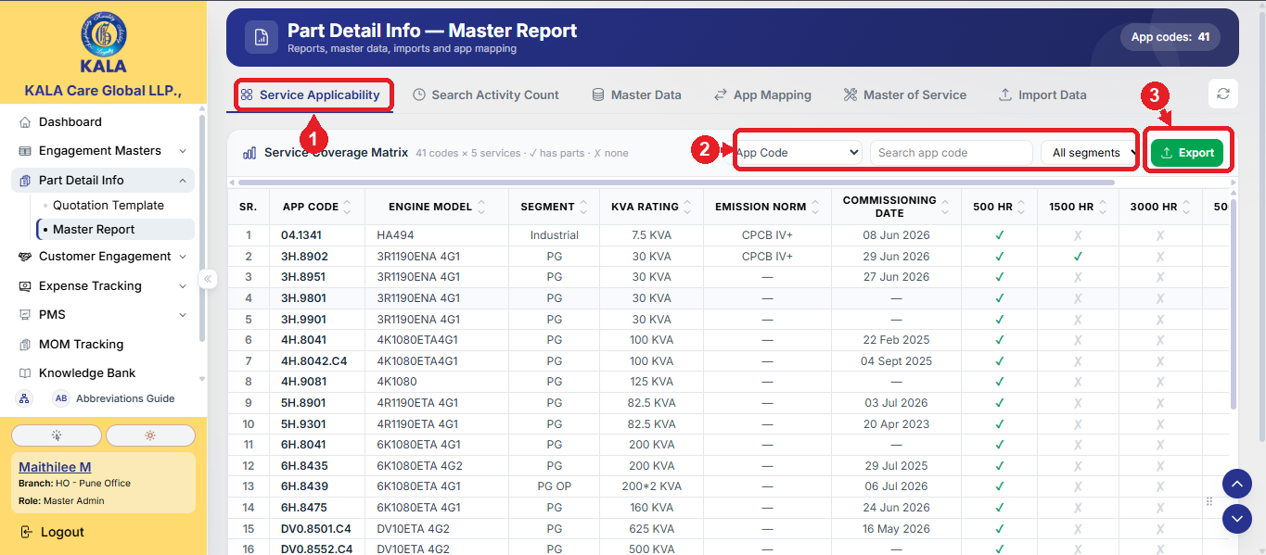
PDI Steps - Section 2: Master Report (Master Admin Only)
Step 1: Open Part Detail Info → Master Report. The first tab Service Applicability ① shows the Service Coverage Matrix - every App Code against every service interval (✓ = parts available, ✗ = none), with Engine Model, Segment, KVA, Emission Norm and Commissioning Date. Use the field-wise search and segment filter ② and column sorting; click Export ③ for the Excel report

Slide 7
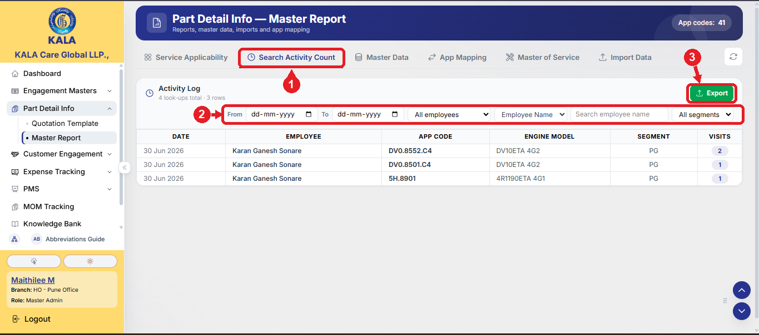
PDI Steps - Section 2: Master Report (Master Admin Only)
Step 2: Search Activity Count ① tab shows the Activity Log - which employee looked up which App Code, on which date and how many times (Visits). Every code selection on the Quotation Template page is logged automatically. Filter by date range, employee or segment ② and click Export ③ for the Excel report

Slide 8
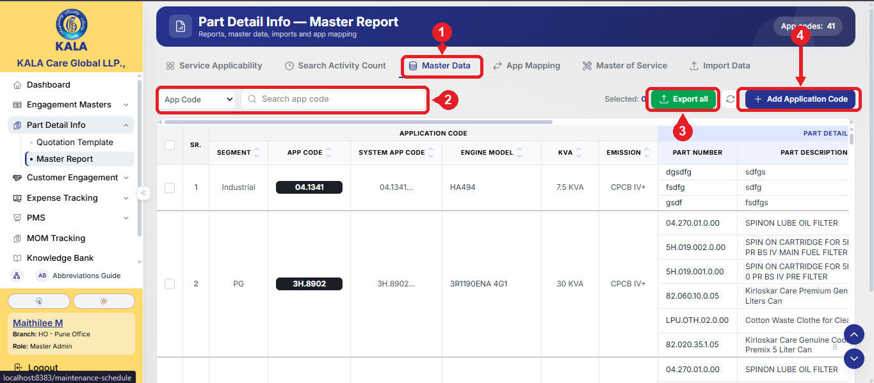
PDI Steps - Section 2: Master Report (Master Admin Only)
Step 3: Master Data ① tab shows the full master sheet - Application Code details with all part lines and kit details, exactly like the master Excel. Search field-wise (including Part / Kit) ②, tick rows to export selected or use Export all ③, and use Add Application Code ④ / Edit / Delete to manage records. The Add form also has a guided flow to build kits from the part lines

Slide 9
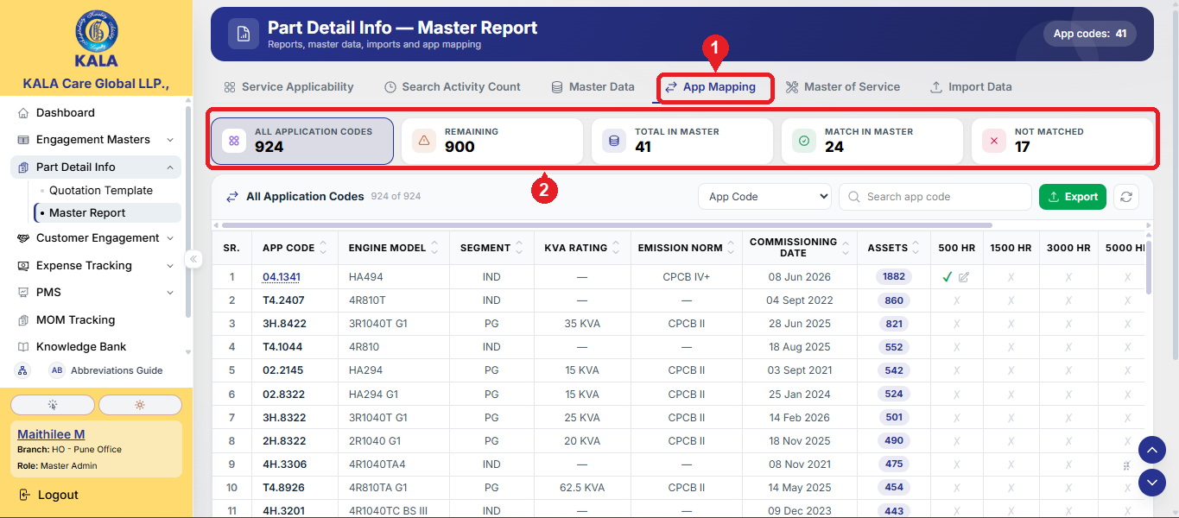
PDI Steps - Section 2: Master Report (Master Admin Only)
Step 4: App Mapping ① tab compares the App Codes of Customers Data Hub (Asset Detailed, active assets) with the PDI master. Click a stat box ② - All Application Codes, Remaining, Total in Master, Match in Master, Not Matched - to see that list with asset counts. Use Add on a remaining code to add it with prefilled details, or click a code to view / edit it. Export gives one Excel with all five lists

Slide 10
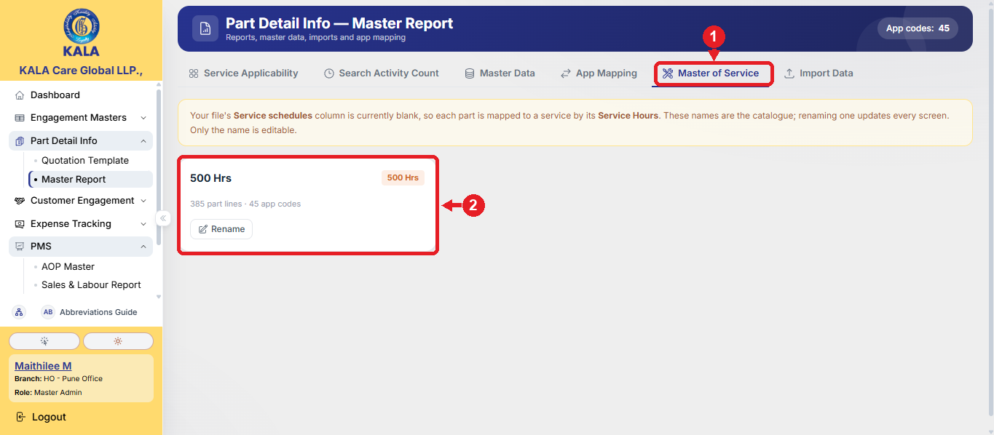
PDI Steps - Section 2: Master Report (Master Admin Only)
Step 5: Master of Service ① tab is the catalogue of service types (e.g., 500 Hrs) with usage counts. Only the name can be changed using Rename on the service card ② - the interval hours are fixed because parts are linked to a service by hours. Renaming updates the name on every screen. New service types are created automatically when an import brings a new interval

Slide 11
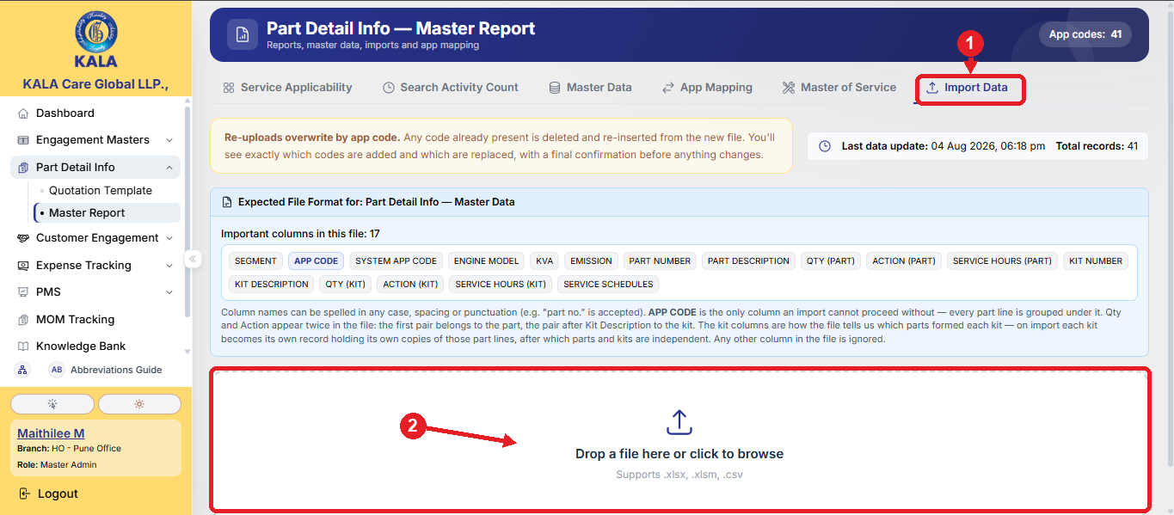
PDI Steps - Section 2: Master Report (Master Admin Only)
Step 6: Import Data ① tab uploads the master Excel (.xlsx / .xlsm / .csv) - drop the file in the upload box ② or click to browse. App Code is the only mandatory column; other column names are matched loosely in any case / spacing. A preview shows which codes will be added and which will be replaced, with a final confirmation. Re-uploads overwrite by App Code - the existing code with its parts and kits is deleted and re-inserted from the file. The upload continues safely even if you move to another page

Slide 12
Quick Reference
Situation | What to do
Need the part list / quotation of a code | Quotation Template → select App Code → tick Type of Service → open the Part or Kit section
Need the quotation as PDF | Quotation Template → Export PDF → Print / Save as PDF
Which codes have parts for which service | Master Report → Service Applicability → search / filter → Export
Who searched which code and how often | Master Report → Search Activity Count → filter by date / employee → Export
Add or correct a code manually | Master Report → Master Data → Add Application Code / Edit / Delete
Bring the master Excel into the system | Master Report → Import Data → drop the file → check the preview → Confirm
An asset's code is missing in the master | Master Report → App Mapping → Remaining → Add (details prefilled from asset data)
Do's and Don'ts
Do | Don't
Verify part details from the master file before Add / Edit | Do not enter wrong or guessed part information - it shows to all users
Check the import preview (Add / Replace counts) before confirming | Do not re-upload a file casually - existing codes are fully replaced
Select the correct Type of Service before exporting the PDF | Do not share the PDF outside - it is for internal use only

Slide 13


